Slide 1

The TRANSLATE() TSQL Operator
An alternative to nested-REPLACE()

Slide 2


REPLACE(stringable, what_phrase, with_what)
“Stringable” refers to anything that can be represented as a string, including numerics, datetimes, guids, etc.
SELECT REPLACE('hello', 'e', 'a')
Number of characters in (what_phrase) do not have to equal number of characters in (with_what)
SELECT REPLACE(123, '3', '6')
Notes:
REPLACE is a very versatile function in TSQL

Slide 3
SELECT REPLACE(
REPLACE(
REPLACE(
REPLACE(ColumnName, '[', '')
, ']', '')
, '(', '')
, ')', '')
FROM ...
Notes:
But it gets overused.
Do you or a loved one suffer from nested REPLACE statements?
Do you properly indent them? (probably not)

Slide 4

SELECT REPLACE(REPLACE(REPLACE(REPLACE(ColumnName, '[', ''), ']', ''), '(', ''), ')', '')
FROM ...
Notes:
They probably look like this.

Slide 5



Jeff Foushee
SQL Server Database Admin
Programmer
SQL Saturday speaker
Blackjack dealer
https://www.linkedin.com/in/jeff-foushee-13b80a100/
https://github.com/jbfoushee/MyPresentations/

Slide 6

Represents 10+ nested REPLACE() functions
Replace these | [ | ] | { | } | ñ | é | “ | ” | ‘ | ’
With these | ( | ) | ( | ) | n | e | " | " | ' | '
DECLARE @_beforemap varchar(12) = '[]{}ñé“”‘’'
DECLARE @_aftermap varchar(12) = '()()ne""'''''
Notes:
So with the prevalence of Autocorrect, smart-quotes and diacritics are becoming more commonplace within free-form data.
And they’re not forgiving when you search upon them.
With the examples I have here, these represent at least 10 REPLACE functions

Slide 7

DECLARE @_beforemap varchar(12) = '[]{}ñé“”‘’'
DECLARE @_aftermap varchar(12) = '()()ne""'''''
SELECT TRANSLATE('“héllo{}”', @_beforemap, @_aftermap)
SELECT TRANSLATE(
'“héllo{}”', '[]{}ñé“”‘’', '()()ne""''''')

Slide 8


DECLARE @_beforemap varchar(3) = '$.,'
DECLARE @_aftermap varchar(3) = '€,.'
DECLARE @_amount varchar(10) = '$2,345.34'
SELECT @_amount
SELECT
TRANSLATE(@_amount, @_beforemap, @_aftermap)

Slide 9


TRANSLATE(stringable, before_map, after_map)
SELECT TRANSLATE('hello', 'E', 'A')
Requires MS SQL 2017+
“Stringable” refers to anything that can be represented as a string, including numerics, datetimes, guids, etc.
Case-sensitivity is determined by collation hierarchy (instance, database, column, query)
SELECT TRANSLATE(123, '3', '6')
Number of characters in (before_map) must equal number of characters in (after_map)
Perfectly fine to re-use characters as targets
Notes:
There are similar functions in DB2, Oracle, and PostgreSQL.
It’s also perfectly fine to re-use characters as source. However, the logic exits out on the first match from left-to-right.

Slide 10
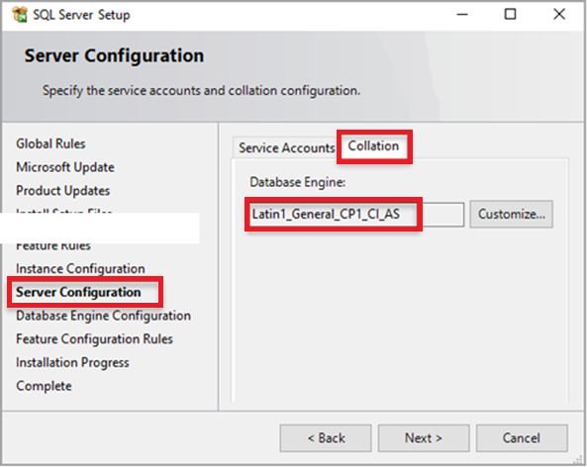
The Collation (Case-Sensitivity) Hierarchy
Instance – What was set when SQL Server was first installed?
SELECT SERVERPROPERTY('collation')

Slide 11
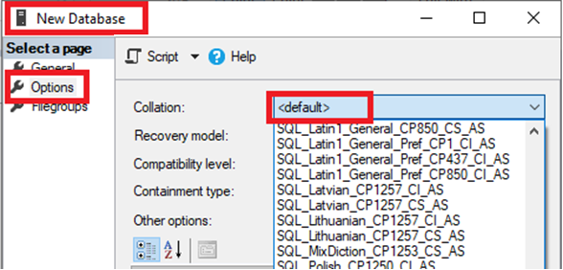
The Collation (Case-Sensitivity) Hierarchy
Instance – What was set when SQL Server was first installed?
Database – Default or explicit?
SELECT DATABASEPROPERTYEX(
DB_NAME(), 'collation')
SELECT [name], collation_name
FROM sys.databases
WHERE name = DB_NAME()

Slide 12
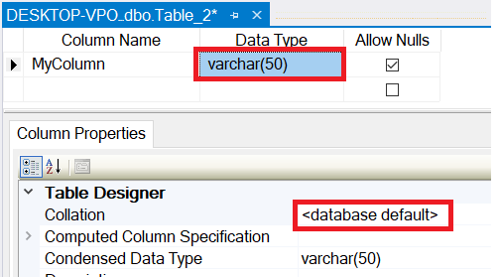
The Collation (Case-Sensitivity) Hierarchy
Instance – What was set when SQL Server was first installed?
Database – Default or explicit?
Table Column – Database default or explicit?
SELECT TABLE_SCHEMA, TABLE_NAME, COLUMN_NAME
, DATA_TYPE
, COLLATION_NAME
, CASE Convert(varchar,IsNull(COLLATION_NAME, ''))
WHEN '' THEN ''
WHEN Convert(varchar, DATABASEPROPERTYEX(DB_NAME(), 'collation')) THEN ''
ELSE '*'
END AS Not_DB_Collation
FROM INFORMATION_SCHEMA.COLUMNS
ORDER BY TABLE_SCHEMA, TABLE_NAME, COLUMN_NAME

Slide 13
The Collation (Case-Sensitivity) Hierarchy
Instance – What was set when SQL Server was first installed?
FROM Table_1 t1
INNER JOIN Table_2 t2
ON t1.SomeColumn
COLLATE
SQL_Latin1_General_CP1_CI_AS
= t2.SomeColumn
Database – Default or explicit?
FROM Table_1 t1
INNER JOIN Table_2 t2
ON t1.SomeColumn = t2.SomeColumn
Table Column – Database default or explicit?
Cannot resolve the collation conflict between "SQL_Latin1_General_CP1_CI_AS" and "Latin1_General_CI_AS" in the equal to operation.
Query-level – temporarily treat it differently for calculation purposes

Slide 14


ROT-13 Encryption
DECLARE @_beforemap varchar(100)
= 'ABCDEFGHIJKLMNOPQRSTUVWXYZabcdefghijklmnopqrstuvwxyz'
DECLARE @_aftermap varchar(100)
= 'NOPQRSTUVWXYZABCDEFGHIJKLMnopqrstuvwxyzabcdefghijklm'
SELECT TRANSLATE(
'Hello' COLLATE Latin1_General_CS_AS
, @_beforemap, @_aftermap) AS [Value]
SELECT TRANSLATE(
'Hello'
, @_beforemap, @_aftermap) AS [Value]
(Mixed-case)
Notes:
The case-sensitive version represents more than 78 REPLACE statements:
A replace to transfer lowercase to an emoji character
- Nested within a replace to transfer uppercase to lowercase version
- Nested within a replace to transfer emoji to upper case version
If you used 52 REPLACE statements to attempt to re-enact this:
A replace to transfer lowercase to uppercase
- Nested within a replace to transfer uppercase to lowercase
Every letter would wind-up lowercase

Slide 15
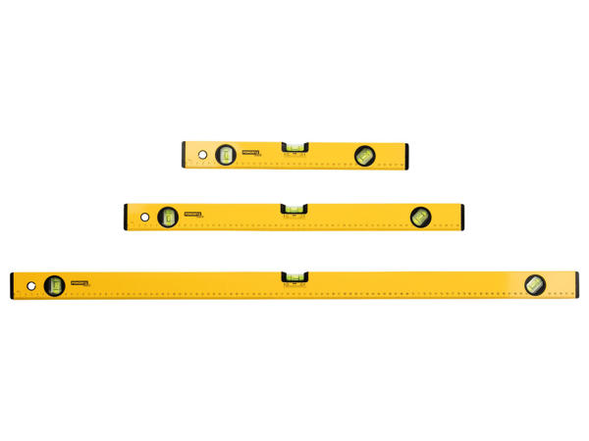
Time for a level-set….
(level set)

Slide 16


ASCII(character)
AND
CHAR(numeric)
PRINT ASCII('A')
PRINT CHAR(65)
PRINT ASCII('a')
PRINT CHAR(97)

Slide 17
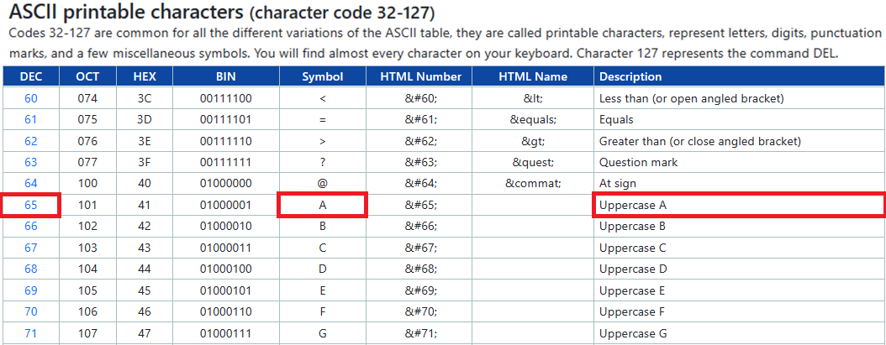
https://www.ascii-code.com/

Slide 18
ASCII(character)
AND
CHAR(numeric)
PRINT ASCII('A')
PRINT CHAR(65)
PRINT ASCII('a')
PRINT CHAR(97)
DECLARE @_value CHAR(65) = CHAR(65)
PRINT CONCAT('"', @_value, '"')

Slide 19
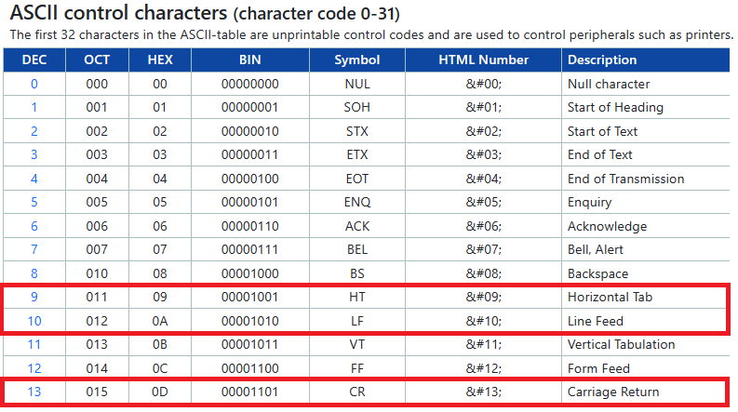
https://www.ascii-code.com/

Slide 20
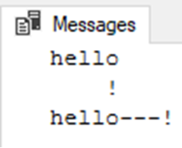
DECLARE @_cr char(1) = CHAR(13)
DECLARE @_lf char(1) = CHAR(10)
DECLARE @_tab char(1) = CHAR(9)
DECLARE @_value varchar(10)
= 'hello' + @_cr + @_lf + @_tab + '!'
DECLARE @_beforemap char(3) = CONCAT(@_cr, @_lf, @_tab)
DECLARE @_aftermap char(3) = '---'
PRINT @_value
PRINT TRANSLATE(@_value, @_beforemap, @_aftermap)

Slide 21
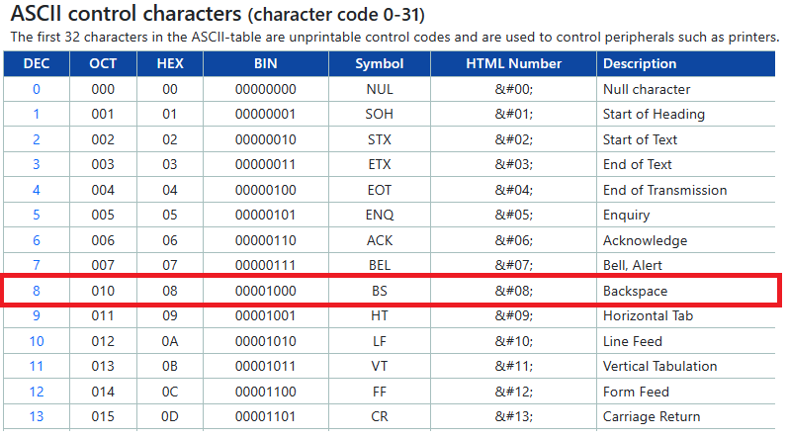
https://www.ascii-code.com/

Slide 22
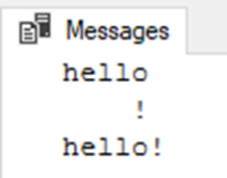
DECLARE @_cr char(1) = CHAR(13)
DECLARE @_lf char(1) = CHAR(10)
DECLARE @_tab char(1) = CHAR(9)
DECLARE @_bksp char(1) = CHAR(8)
DECLARE @_value varchar(10)
= 'hello' + @_cr + @_lf + @_tab + '!'
DECLARE @_beforemap char(3) = CONCAT(@_cr, @_lf, @_tab)
DECLARE @_aftermap char(3) = CONCAT(@_bksp, @_bksp, @_bksp)
PRINT @_value
PRINT TRANSLATE(@_value, @_beforemap, @_aftermap)

Slide 23
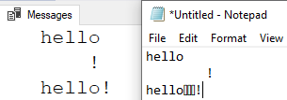
Gotcha!
CHAR(8) in action
Notes:
Bonus: Try this exercise again with CHAR(0), the NULL character. What happens?

Slide 24
DECLARE @_cr char(1) = CHAR(13)
DECLARE @_lf char(1) = CHAR(10)
DECLARE @_tab char(1) = CHAR(9)
DECLARE @_value varchar(10)
= 'hello' + @_cr + @_lf + @_tab + '!'
DECLARE @_beforemap char(3) = CONCAT(@_cr, @_lf, @_tab)
DECLARE @_aftermap char(3) = '•••'
PRINT @_value
PRINT REPLACE(
TRANSLATE(@_value, @_beforemap, @_aftermap), '•', '')

Slide 25
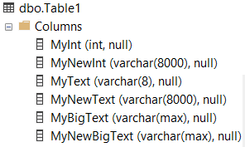
Another Gotcha!
DECLARE @_myint int = 123
DECLARE @_mytext varchar(8) = 'hello'
DECLARE @_mybigtext varchar(max) = REPLICATE('hello ', 2000)
SELECT @_myint AS MyInt
, TRANSLATE(@_myint, '3', '6')
AS MyNewInt
, @_mytext AS MyText
, TRANSLATE(@_mytext, 'E', 'A')
AS MyNewText
, @_mybigtext AS MyBigText
, TRANSLATE(@_mybigtext, 'E', 'A')
AS MyNewBigText
INTO dbo.Table1
Notes:
Everything “Translated” promoted datatypes

Slide 26
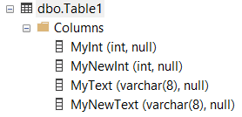
Another Gotcha! - Fixed
DECLARE @_myint int = 123
DECLARE @_mytext varchar(8) = 'hello'
SELECT @_myint AS MyInt
, TRY_CONVERT(int, TRANSLATE(@_myint, '3', '6'))
AS MyNewInt
, @_mytext AS MyText
, CONVERT(varchar(8),
TRANSLATE(@_mytext, 'E', 'A'))
AS MyNewText
INTO dbo.Table1

Slide 27
Putting it all together
TRANSLATE() is used for “one-for-one” character-for-character replacement.
TRANSLATE() is inherently case-insensitive unless forced otherwise
TRANSLATE() fails at character removal. Use REPLACE() for those cases.
TRANSLATE() can cast the resulting value into a larger datatype, potentially
slowing down ETL.

Slide 28
Jeff Foushee
SQL Server Database Admin
Programmer
SQL Saturday speaker
Blackjack dealer
https://www.linkedin.com/in/jeff-foushee-13b80a100/
https://github.com/jbfoushee/MyPresentations/

